Slide 1
XYZ BANK Case Study
Project: Customer Segmentation
Mamadi Fofana - LISUM02
October 2021
GitHub Repo link : https://github.com/mfofanagn/Customer-segmentation

Slide 2
Project summary
Problem Statement:
XYZ bank wants to roll out Christmas offers to their customers. But Bank does not want to roll out same offer to all customers instead they want to roll out personalized offer to particular set of customers. If they manually start understanding the category of customer then this will be not efficient and also, they will not be able to uncover the hidden pattern in the data (pattern which group certain kind of customer in one category). Bank approached ABC analytics company to solve their problem. Bank also shared information with ABC analytics that they don't want more than 5 group as this will be inefficient for their campaign.
Project delivery:
The outcome of our delivery will be first a presentation of actionable recommendations and insights to XYZ’s bank to help them improve understanding and quality of their data.
Then, we will use customer segmentation approach using clustering models which group similar behavior customers in one category and others in different category to help them manage better their Christmas offers to their customers.

Slide 3
Project summary
This presentation will be divided into four parts
Dataset
Analysis
Recommendations
Recommended models

Slide 4
Project dataset
We have been provided with data sets (cust_seg.csv) which contains information on a bank customer which represents different aspects of the customer profile.
Data source contains 47 features for around 1000.000 records of clients
Problems in the data
After descriptive and correlation analysis, we encountered some issues in the data
Missing value
High percentage of missing values in some columns in features
Column with unique categorical value
Low entropy in some categorical attributes.
high correlated columns

Slide 5
Project dataset
Columns with high cardinality
Data in wrong format
Outliers and errors
Data not scaled for some numerical variable
After data cleaning, we finally got a new data structure of 14 features for 935.144 records

Slide 6
Analysis
In order to help XYZ bank to better understand their data and to roll out Christmas offers to their customers; our analysis will be based essentially upon :
Descriptive analysis
Correlation analysis,
Numerical correlation
Categorical correlation

Slide 7
Analysis
We will try during our analysis to verify certain hypothesis:
Is there any relationship between Customer relationship at the beginning of the month and customer
enabled status ?
Is there any relationship between long term deposit and gross income ?
Is there any relationship between long term deposit and customer seniority ?
Is there any relationship between long term deposit and customer age ?
Is there any relationship between eaccount and customer age ?

Slide 8
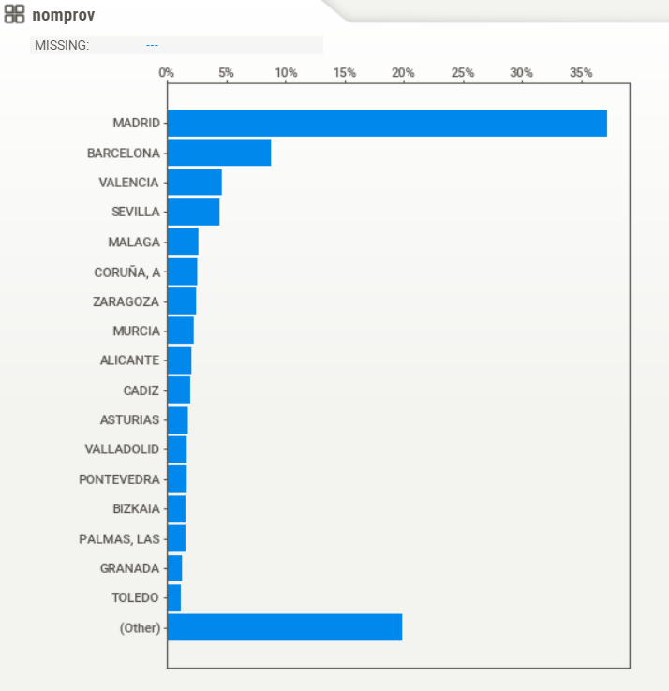
Customer distribution per town
We can observe an over-representation of the city of Madrid which can be explained by the fact that Madrid is the capital of the country

Slide 9
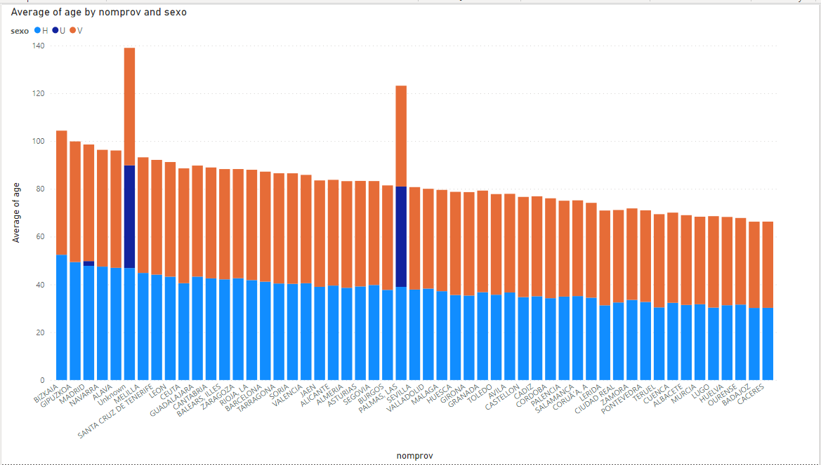
Average age by province and gender
We noticed that average age is quite similar for both gender for most of provinces (nomprov) except for few provinces.
Only province ‘Las palmas ‘has a significant missing value for age variable
Also, a new category (Unknown) has been created to impute missing value for variable ‘nomprov’

Slide 10
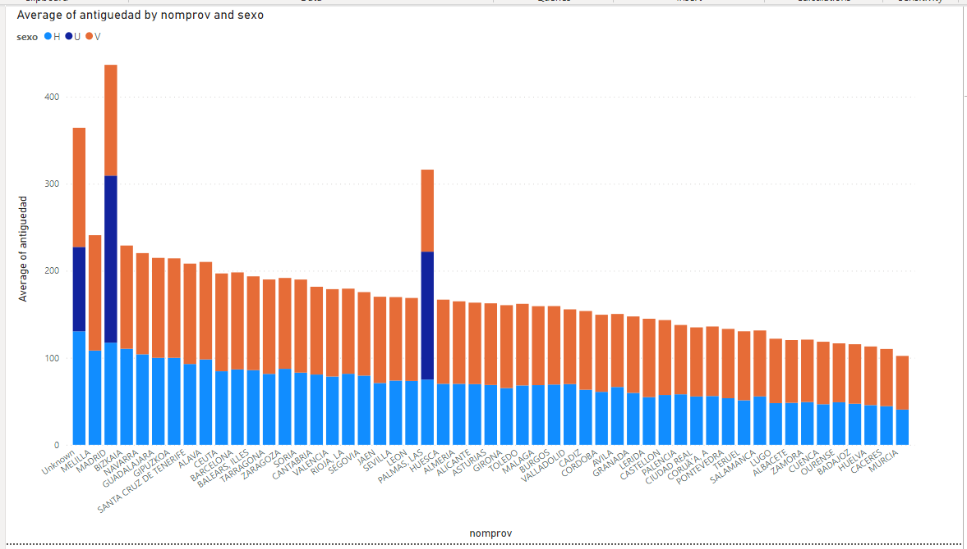
Average seniority by province and gender
We noticed that average seniority is quite similar for both gender for most of provinces (nomprov) except for few provinces
Only province ‘Las palmas ‘ and ‘madrid’ have a significant missing value for seniority variable
Also, a new category (Unknown) has been created to impute missing value for variable ‘nomprov’

Slide 11
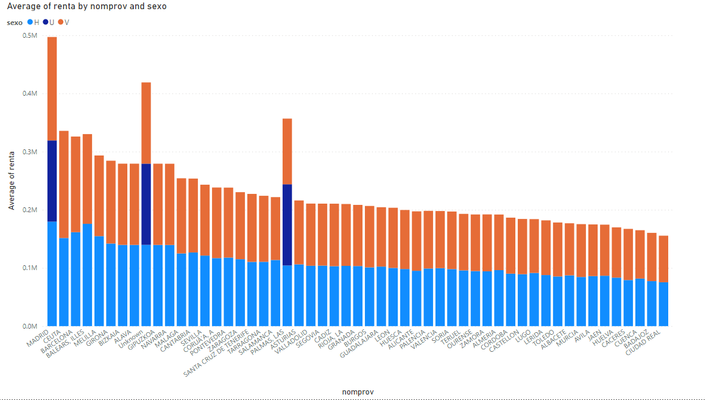
Average gross income by province and gender
We noticed that average gross income is quite similar for both gender for most of provinces (nomprov) except for few provinces (ie ‘madrid’ , ‘balnear iles’ etc.)
Only province ‘Las palmas ‘ and ‘madrid’ have a significant missing value for gross income variable
Also, a new category (Unknown) has been created to impute missing value for variable ‘nomprov’

Slide 12
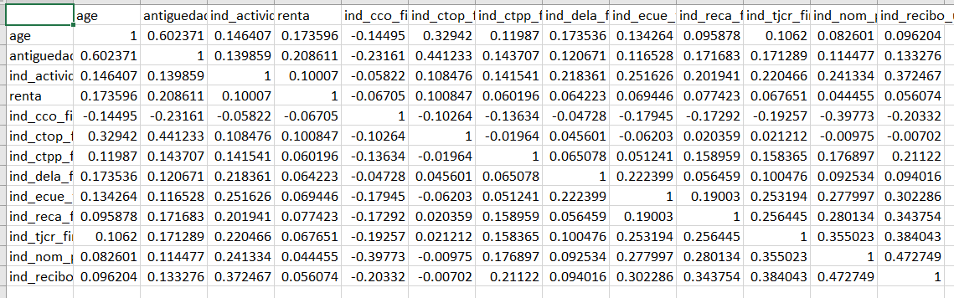
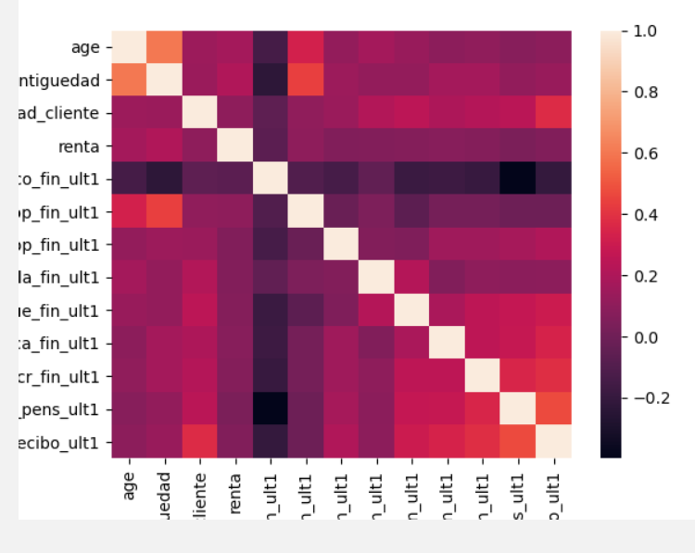
Numerical correlation
We noticed a weak correlation between features after data cleaning phase

Slide 13
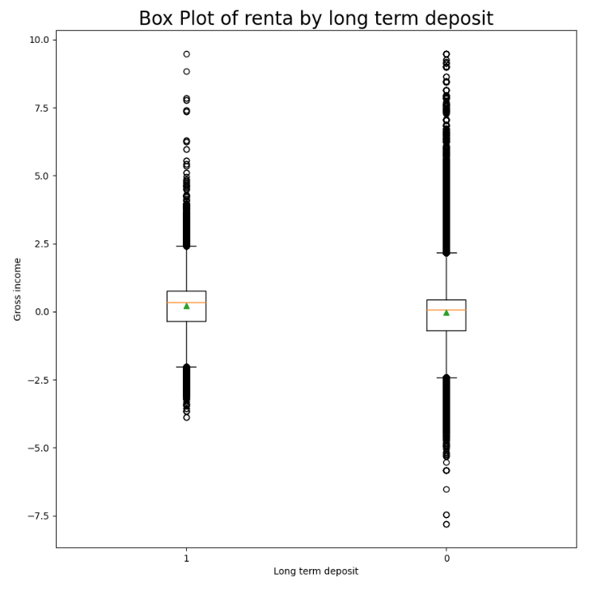
Anova test between feature 'renta' and 'ind_dela_fin_ult1'
We need to test if it exists a relationship between long term deposit and Gross income of the household The null hypothesis is the mean of gross income between category of long-term deposit is equal
pValue equal 0 which means that we can reject null hypothesis: So, long term deposit could be related to gross income We can observe this fact also in the Boxplot

Slide 14
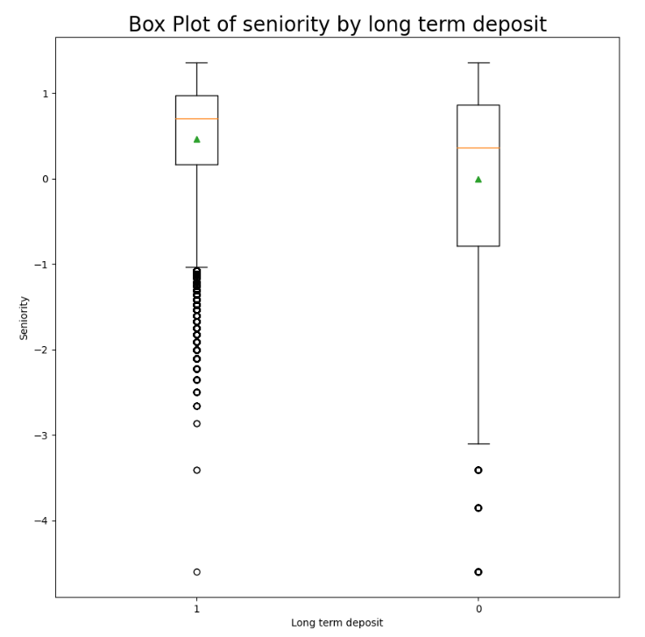
Anova test between feature 'antiguedad' and 'ind_dela_fin_ult1'
We need to test if it exists a relationship between long term deposit and customer seniority The null hypothesis is the mean of customer seniority between category of long-term deposit is equal
pValue equal 0 which means that we can reject null hypothesis: So, long term deposit could be related to customer seniority We can observe this fact also in the Boxplot

Slide 15
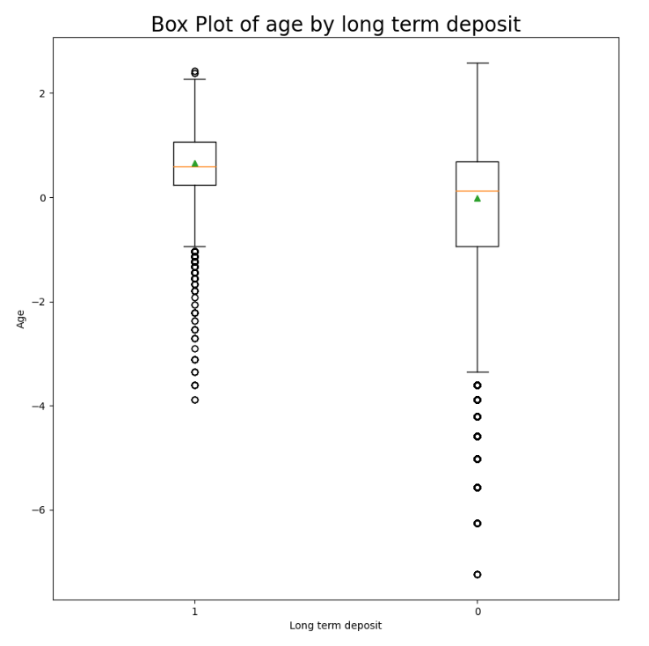
Anova test between feature 'age' and 'ind_dela_fin_ult1'
We need to test if it exists a relationship between long term deposit and age The null hypothesis is the mean of age between category of long-term deposit is equal
pValue equal 0 which means that we can reject null hypothesis: So, long term deposit could be related to customer age We can observe this fact also in the Boxplot

Slide 16
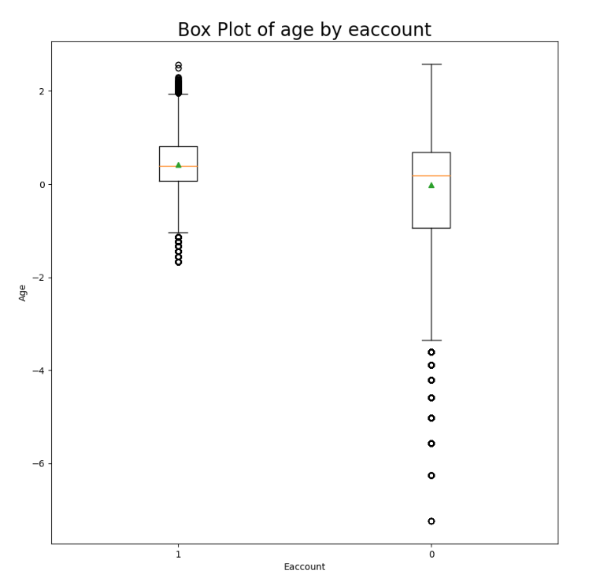
Anova test between feature 'age' and 'ind_ecue_fin_ult1'
We need to test if it exists a relationship between eaccount and age The null hypothesis is the mean of age between category of eaccount is equal
pValue equal 0 which means that we can reject null hypothesis: So having eaccount could be related to age We can observe this fact also in the Boxplot

Slide 17
Chi-Square Test for independence between 'tiprel_1mes' and 'ind_actividad_cliente'
pValue equal 0 which means that we can reject null hypothesis :
So tiprel_1mes and ind_actividad_cliente are strongly dependant

Slide 18
Recommendations
Following our analysis, we notice that:
We can reduce number of study variables since most of them
are not necessary to the analysis
We need to improve data collect in some provinces, especially for ‘madrid’
and ‘Las palmas’ since those variables contains a lot of missing data
We have tested 5 hypotheses with following conclusions:
Customer relationship at the beginning of the month and customer activation are strongly dependent
Long term deposit could be related to gross income
Long term deposit could be related to customer seniority
Long term deposit could be related to customer age
Having eaccount could be related to age

Slide 19
Recommended Model
Clustering is an unsupervised learning method whose task is to divide the population or data points into a number of groups, such that data points in a group are more similar to other data points in the same group and dissimilar to the data points in other groups.
It is basically a collection of objects based on similarity and dissimilarity between them.
Challenges : Clustering on Mixed Data Types
Our dataset is a mixed data types and there are a number of clustering algorithms that can appropriately handle mixed data types.
Some possibilities include the following:
Partitioning-based algorithms: k-Prototypes, Squeezer.
Hierarchical algorithms: ROCK, Agglomerative single, average, and complete linkage.
Density-based algorithms: HIERDENC, MULIC, CLIQUE.
Model-based algorithms: SVM clustering, Self-organizing maps.
In the case of this study, we will adopt Kmodes algorithm which is used for clustering categorical variables.
In order to manage continuous variable with KModes, we will convert continuous features into categorical features

Slide 20
Recommended Model
k-modes algorithm
k-modes is one of the unsupervised Machine Learning algorithms .
It defines clusters based on the number of matching categories between data points.
The k-Modes is created by Huang as the alternative of clustering analysis for categorical data only.
Instead of using the average as the parameters to find out the cluster’s centroids, the k-Modes use the modes.
The mechanism of finding the cluster’s centroid in the k-Modes is similar to the k-Means.

Slide 21
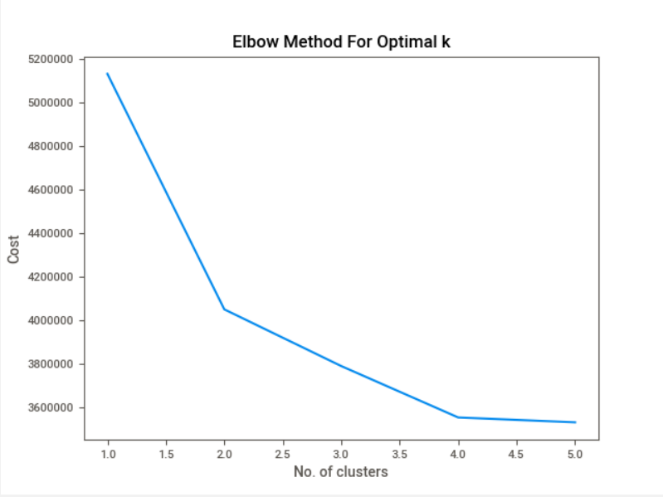
Recommended Model
We observe that making only 2 groups in the best choose
Christmas offers to their customers

Slide 22
Recommended Model
Snapshot of summaries of the two groups:
First group could match older people with more revenue and former customer relationship
Second group could match young people with fewer revenue and newer customer relationship

